Slide 1




Project Title
GhostNet: LLM-Driven Legacy Twin Using
Multi-Modal Personal Data Embedding

Slide 2
Team Members:
Guide Name:
Swathi
Jayasri
Keerthana
Arthi
Mrs. E. Thamizharasi

Slide 3
Problem Statement
"In today's digital world, people leave behind a rich trail of conversations, thoughts, and memories across messages, social media, journals, and emails. However, once a person is gone or becomes unreachable, their perspective, voice, and wisdom are lost. Despite advances in artificial intelligence, there is no meaningful way to preserve and simulate a person’s communication style, personality, and life experience in a private, secure, and accessible way. GhostNet addresses this gap by creating an AI-powered ‘memory twin’ that can learn from a person's digital footprint and mimic their tone, style, and knowledge to continue conversations, recall past thoughts, and offer guidance. This application runs entirely on a personal device or browser, requiring no specialized hardware, ensuring it is accessible, private, and emotionally impactful."

Slide 4
Domain
Artificial Intelligence (AI)
Machine Learning (ML)
Natural Language Processing (NLP)
Digital Twin Technology
Privacy-Preserving Computing
Human-Computer Interaction

Slide 5
Abstract
GhostNet is an AI project that creates a digital twin of a person using their digital footprints like messages, emails, voice notes, and posts. This twin behaves like the real person — it can reply, share memories, and show emotions. It helps in emotional support, memory preservation, and virtual legacy after the person is no longer around. The system also protects user privacy and ensures secure use of sensitive data.

Slide 6
Objectives
To create a digital memory twin of a person using AI
To simulate real-life conversation and emotional behavior
To allow interaction even after someone is gone To ensure user privacy and ethical data use
To support virtual remembrance and legacy keeping

Slide 7
WORKING
1. Collect digital data (chats, audio, social posts)
2. Preprocess and clean the data
3. Train AI model using NLP and ML
4. Build the digital twin with personality traits
5. User interacts through a chatbot/voice system
6. Responses are generated based on learned behavior

Slide 8
Technologies & Tools
Programming: Python
Libraries: TensorFlow, NLTK, Transformers Tools: Google Colab, Jupyter Notebook
Models: ChatGPT (for simulation), Speech-to-Text, Text-to-Speech
Security: Data encryption techniques

Slide 9
Expected Output
A working AI-based legacy twin chatbot It will talk, respond, and behave like the original person A private and secure interface for loved ones to interact Emotionally rich conversations Text and voice mode interaction

Slide 10
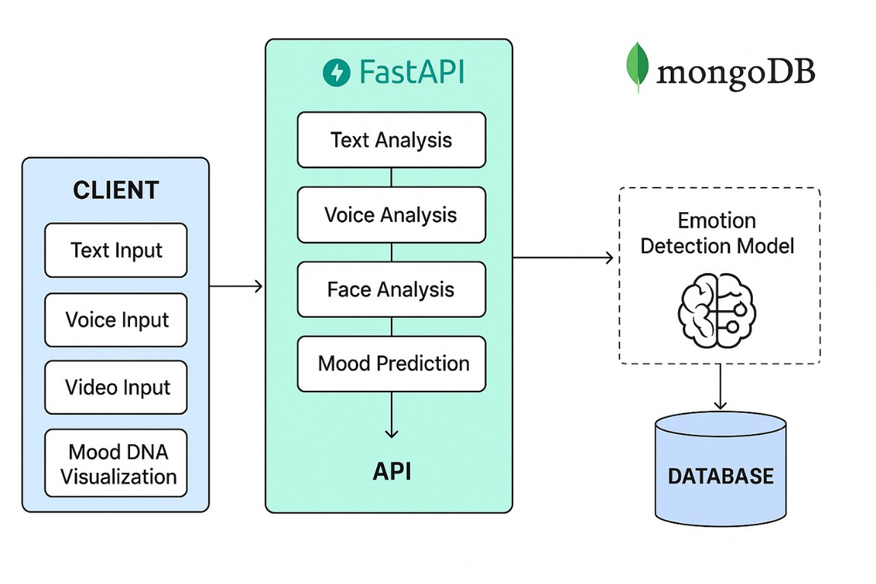
ARCHITECTURE

Slide 11
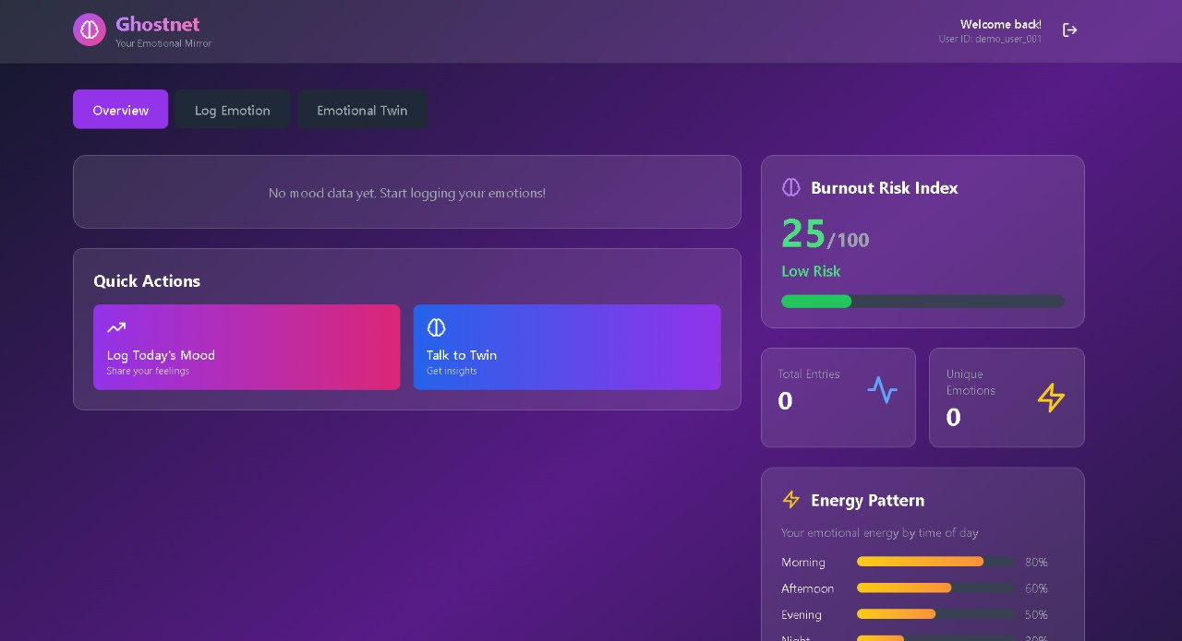
IMPLEMENTATION

Slide 12
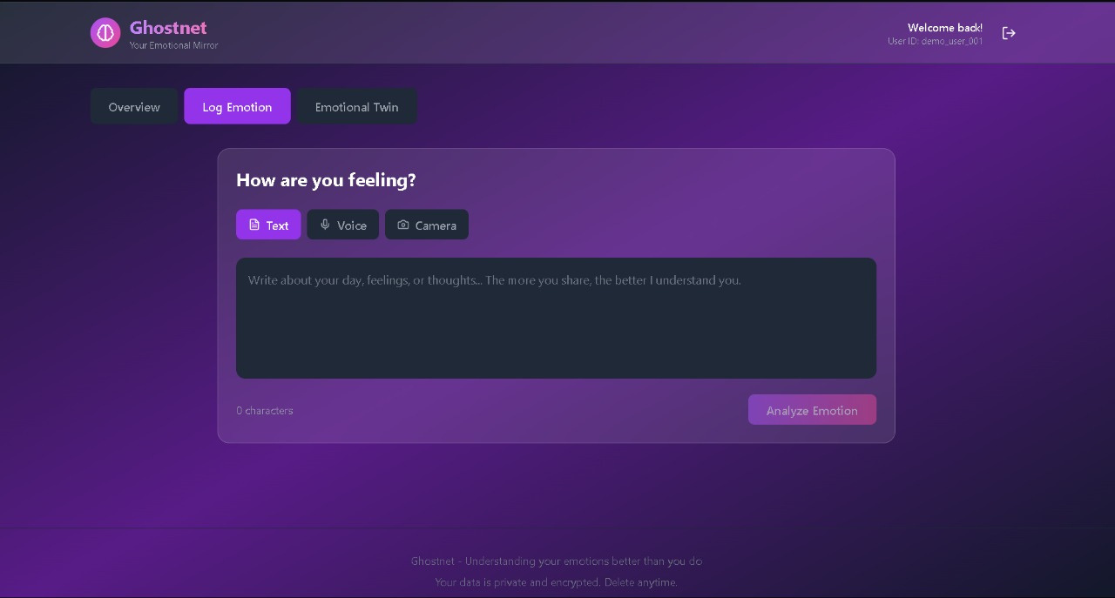

Slide 13
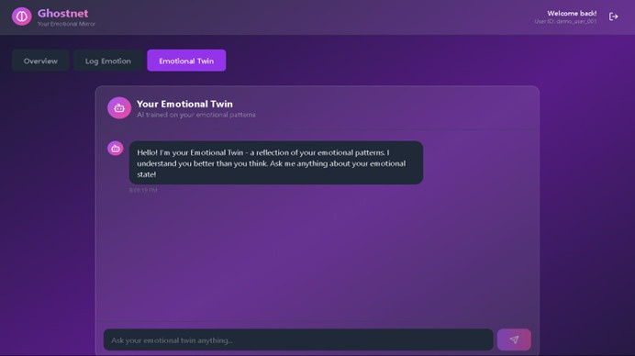

Slide 14
Future Scope
Adding 3D avatars for visual interaction
Real-time voice cloning Use in elderly care and dementia patients
Integration with VR/AR for immersive memories
Used in historical preservation of famous personalities

Slide 15
Conclusion
GhostNet is a step forward in using AI for emotional connection and digital remembrance. It helps preserve the identity of people and allows future generations to know them. This project shows how AI can support legacy, love, and memories, even when someone is no longer physically present.

Slide 16
Thank you

